Slide 1
AWS S3 Versioning
Presented By KV Prem Kumar

Slide 2
Amazon S3 Versioning:
S3 Versioning is a feature provided by Amazon Web Services (AWS) that allows you to keep multiple versions of an object in an Amazon S3 bucket. When versioning is enabled, S3 automatically assigns a unique version ID to each object stored in the bucket. This enables you to preserve, retrieve, and restore every version of every object in your bucket.

Slide 3
Enabling Versioning
Versioning can be enabled at the bucket level, and once enabled, it applies to all objects in the bucket.
Once versioning is enabled, it is impossible to turn it off, but you can suspend it.

Slide 4
Steps to Set Up S3 Bucket Versioning
Login to the AWS Account.
In the console search for S3 in the search bar.

Slide 5
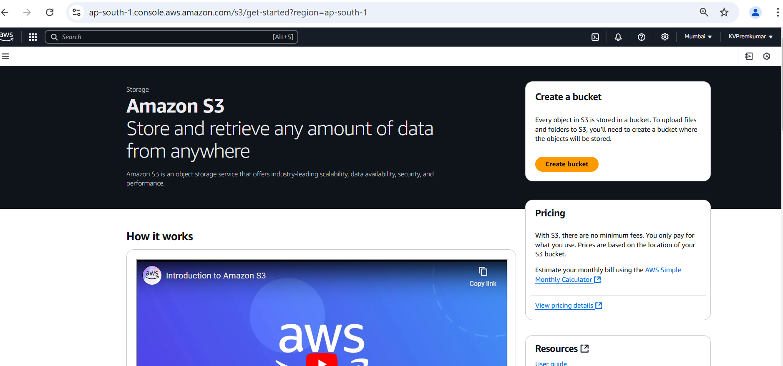
Go to S3 Console.
Click on Create Bucket.

Slide 6
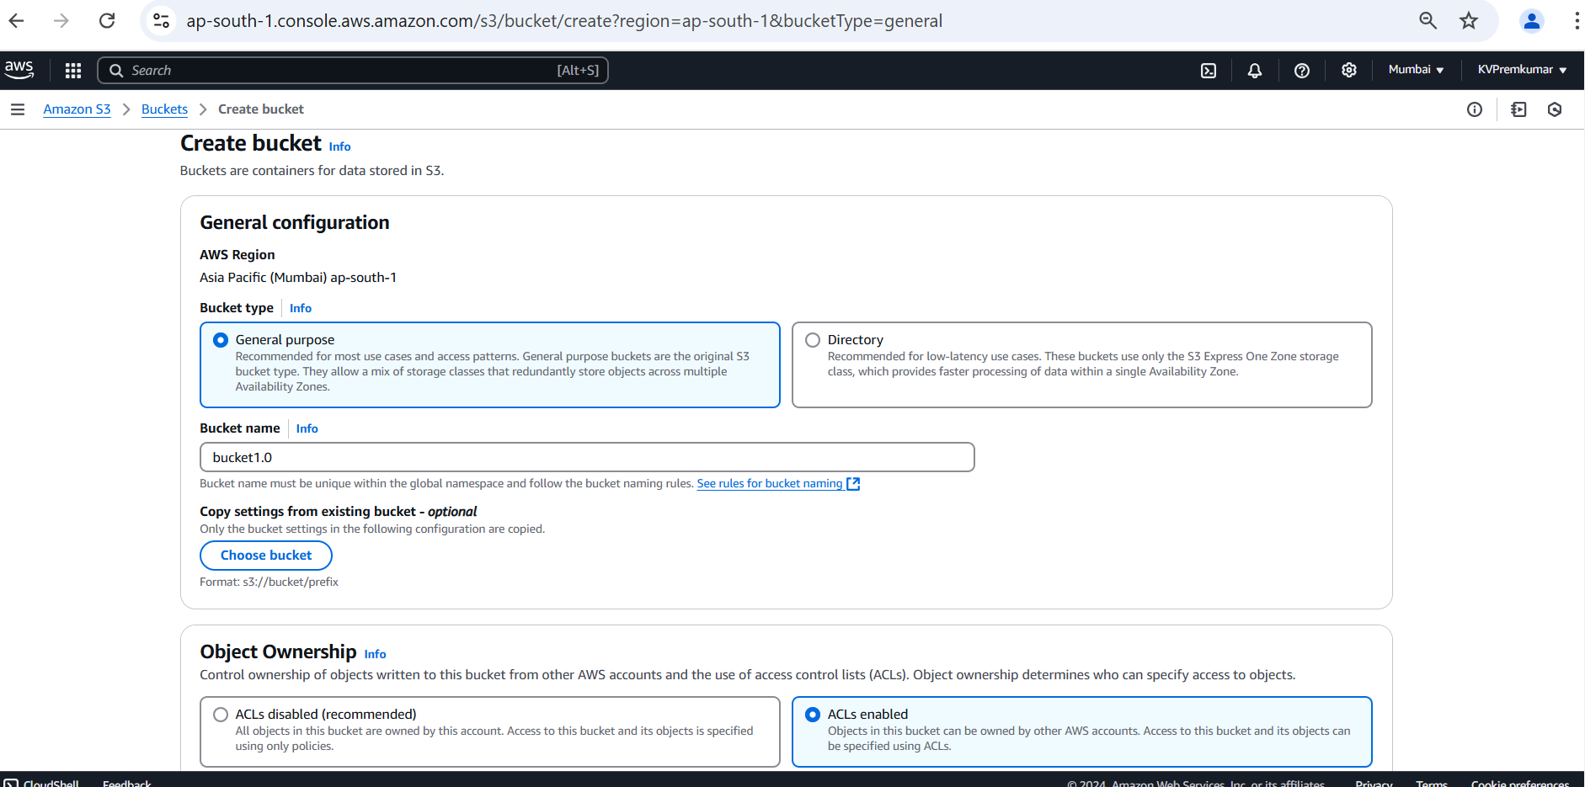
In General configuration select the bucket type as General Purpose.
Give the unique name to the bucket.
Enable the ACLs in Object Ownership.

Slide 7
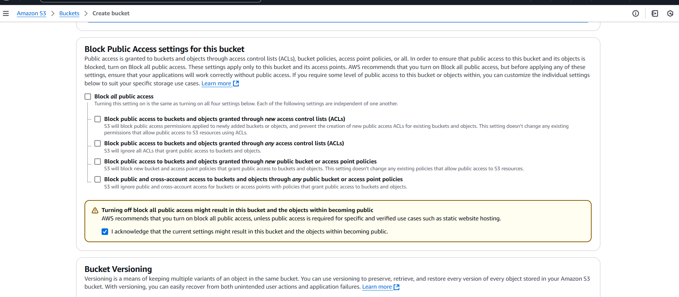
Deselect the Block all public access.
Select the Acknowledge option to off the block all public access.

Slide 8
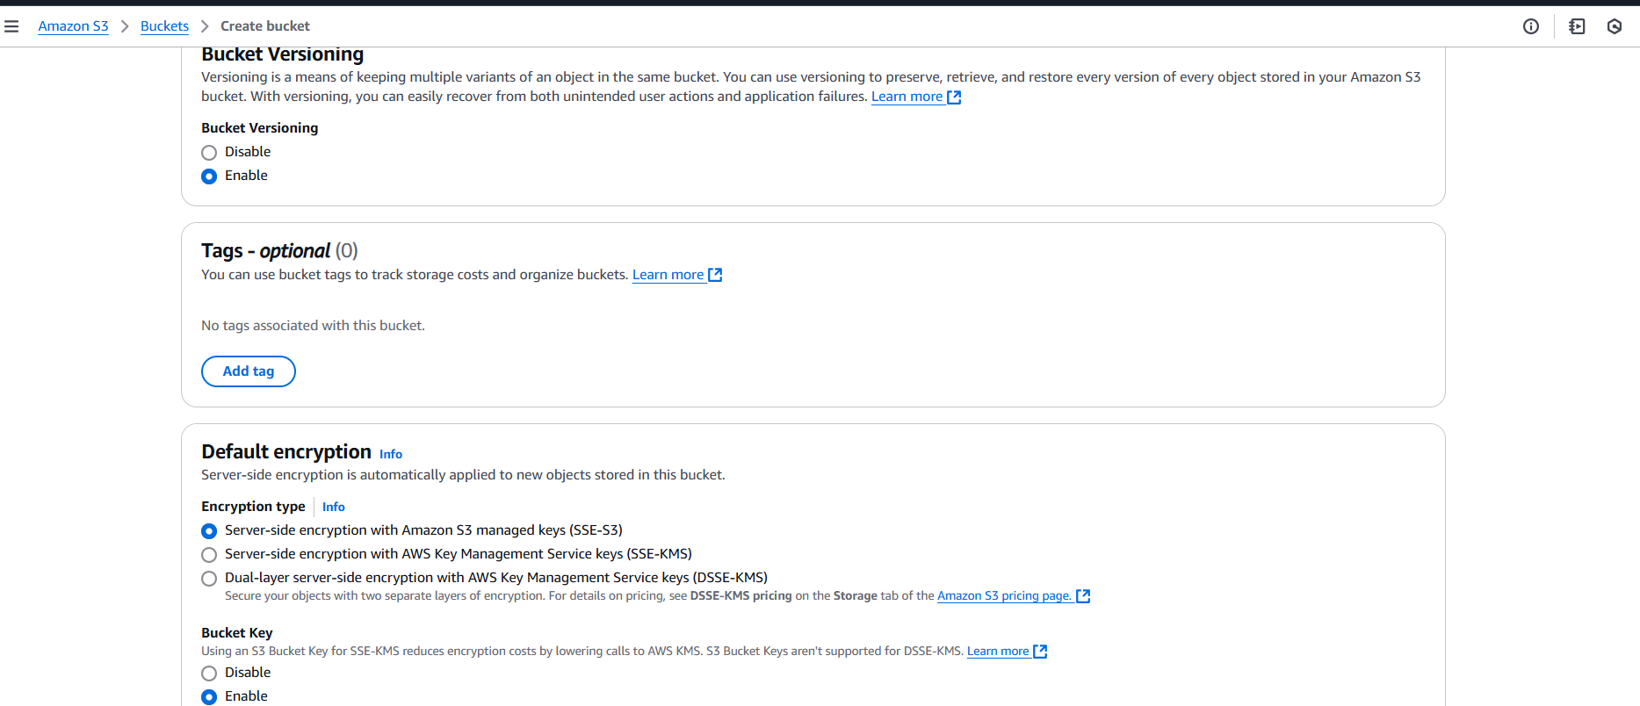
Enable the Bucket Versioning.
Keep the remaining all in default and Click on Create Bucket.

Slide 9
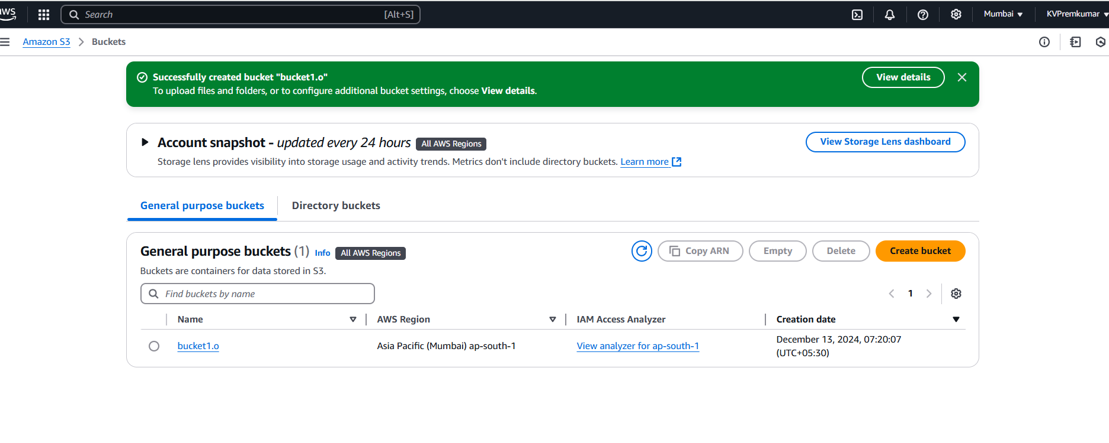
Here we can see the bucket creation.
Click on the bucket to open.

Slide 10
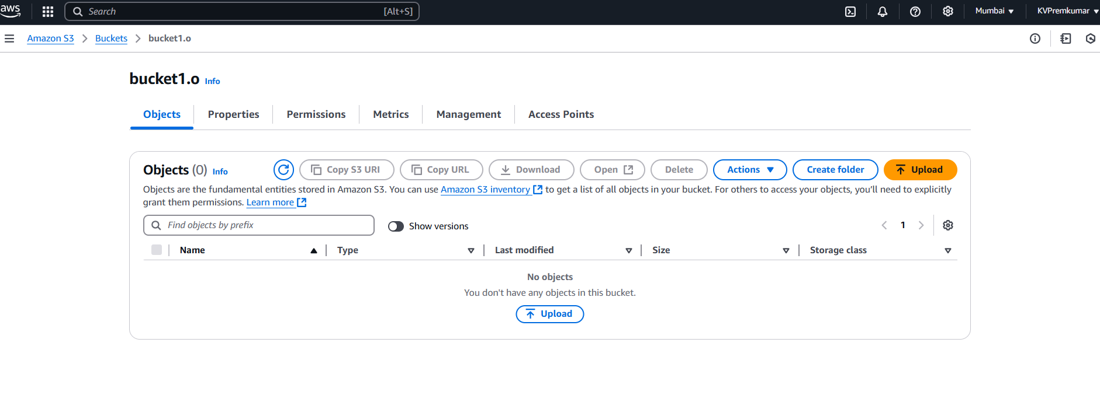
After opening the bucket, click on Upload.

Slide 11
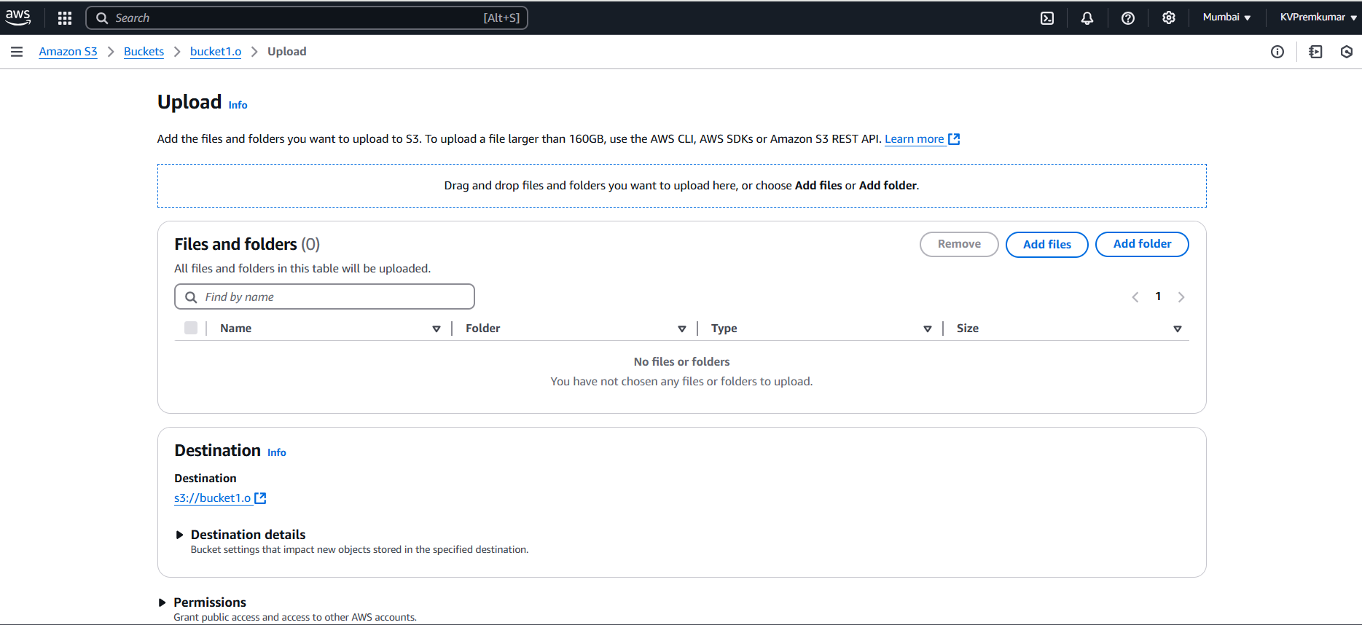
In Upload select Add File.

Slide 12
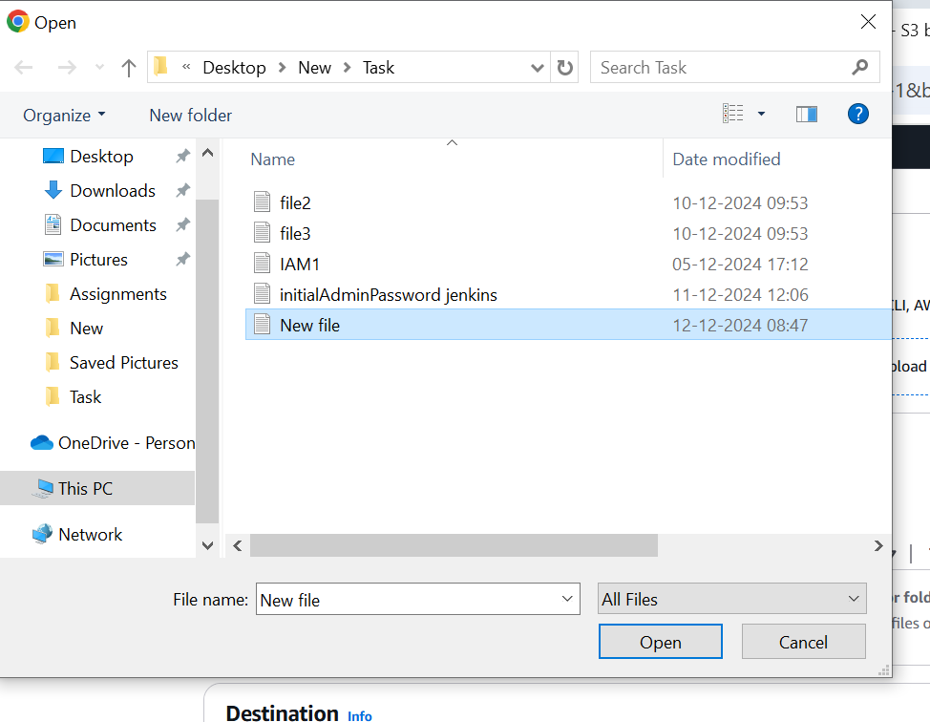
Select the file which you wants to upload.

Slide 13
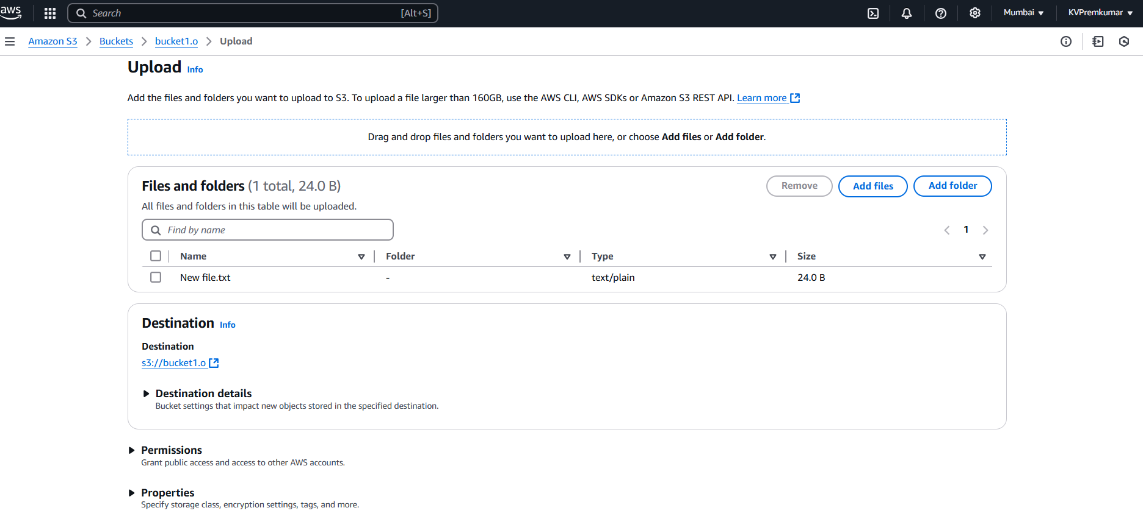
Here we see the selected file to upload.

Slide 14
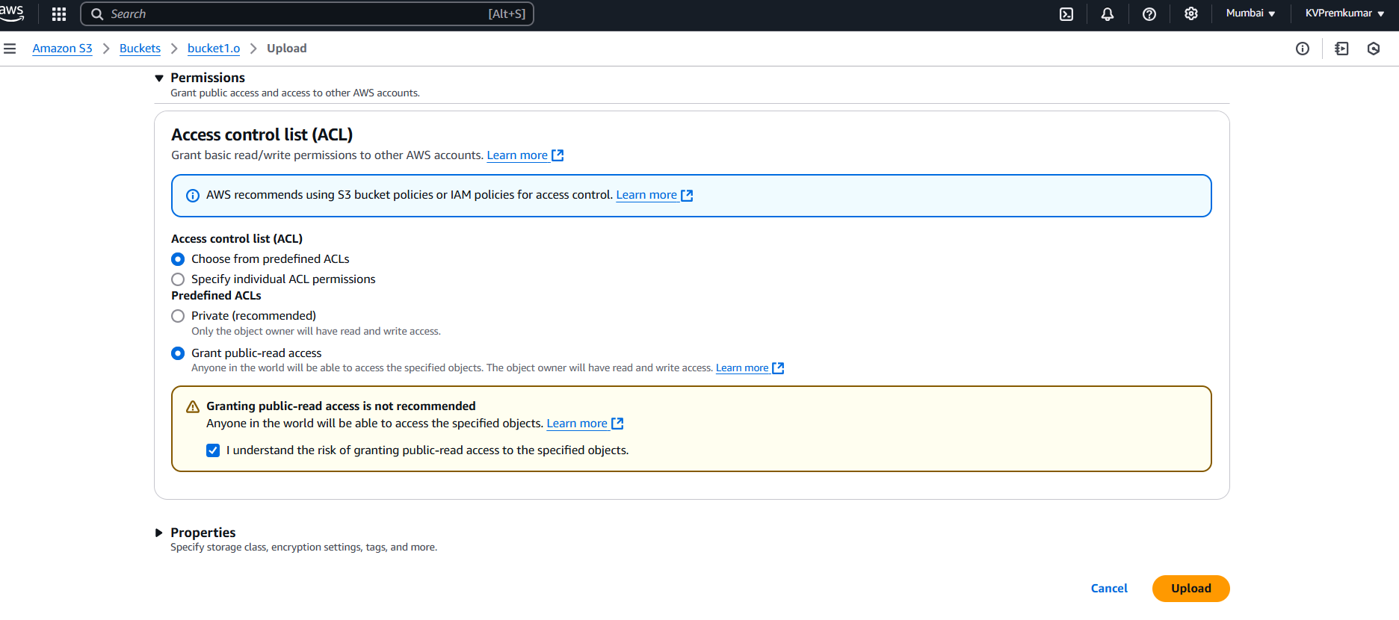
If you scroll down we will see the permissions.
We can select the Grant public-read access to make data visible in the object (optional) and after click on upload.

Slide 15

Here we can see the file is uploaded in bucket.

Slide 16
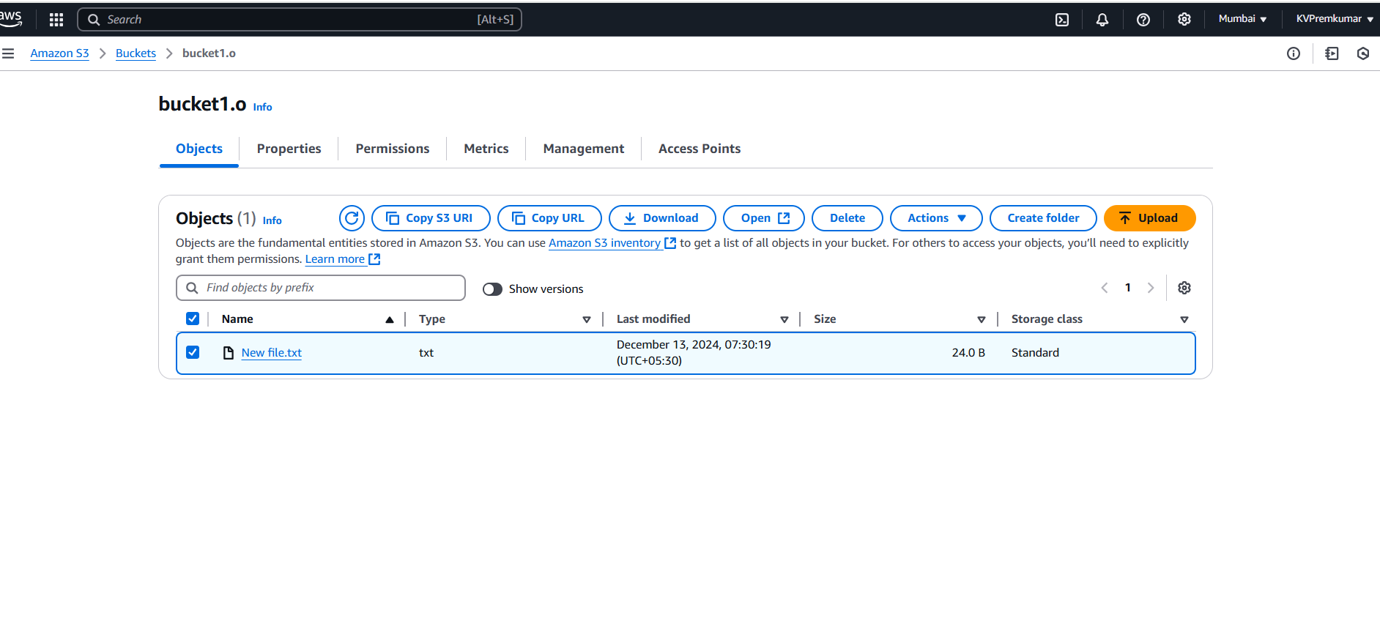
Select the file and click on Open to see the data in the file.

Slide 17
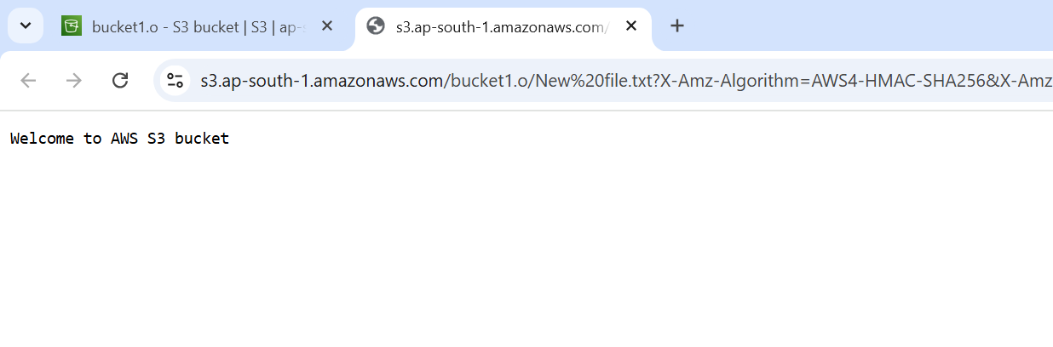
Here we can see the data in the file.

Slide 18
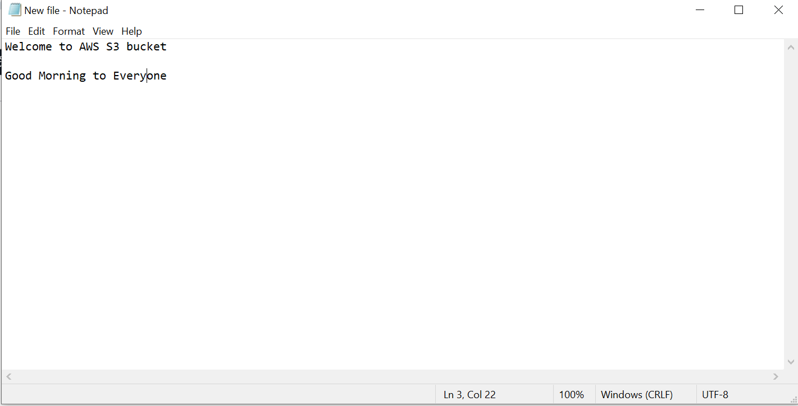
Open the file and update the data in the file and save.

Slide 19
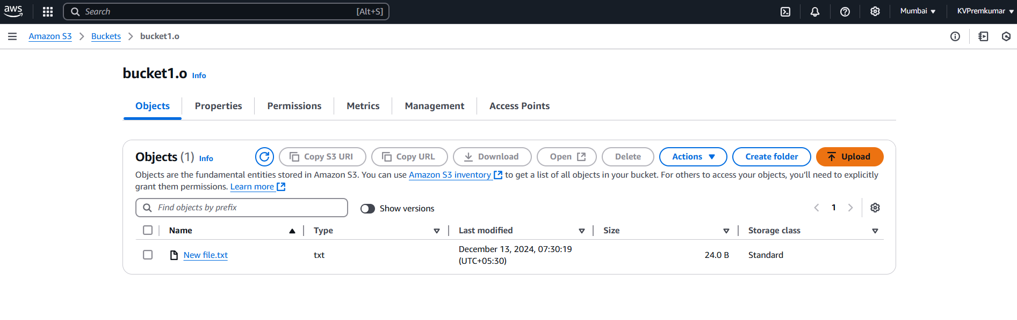
Go Back in to the bucket and click on upload and select add files.

Slide 20
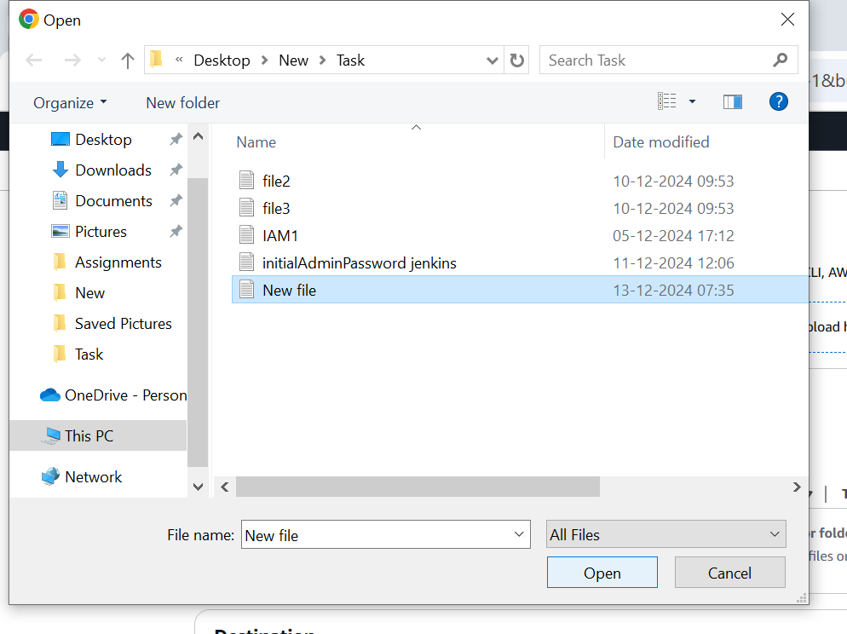
Upload the updated file again in the bucket without changing the name of the file and also with the same permissions.
Again open the file to check the data.

Slide 21

Here we can see the data is updated

Slide 22
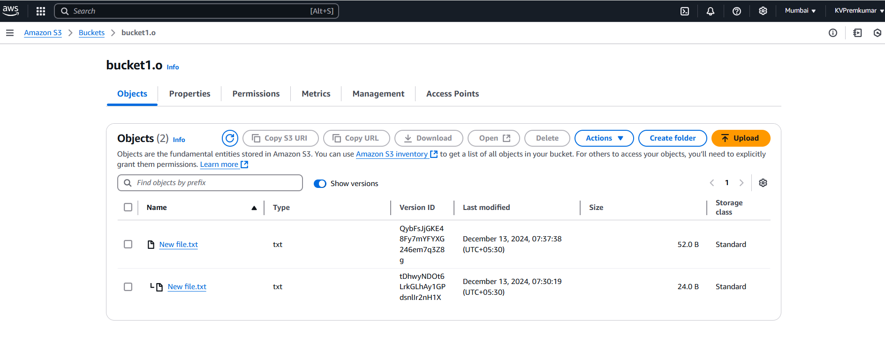
Go back to the bucket and select show versioning.
He we can see the old version object is not deleted because we enabled the Versioning.

Slide 23
Thankyou

